Slide 1
Writing Robust and Maintainable Concurrent Program
Wilson Tjhi
@wilsontjhi
Github: wilsontjhi/pycon-asia-2018

Slide 2
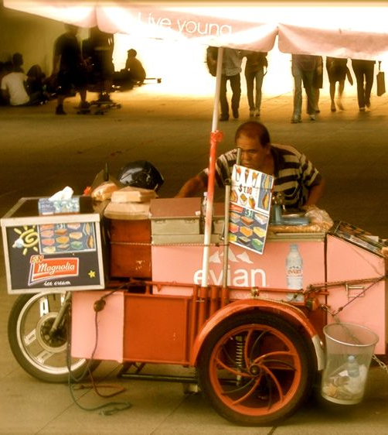
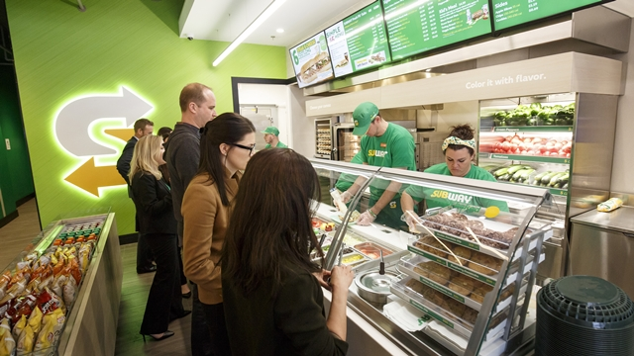

What lessons can we learn from food seller about concurrency?

Slide 3

Making of kue lapis sagu
Notes:
Traditional snack from SEA
It is made by combining layers of colors
This particular one has magenta, green, white, and then it repeats again.

Slide 4
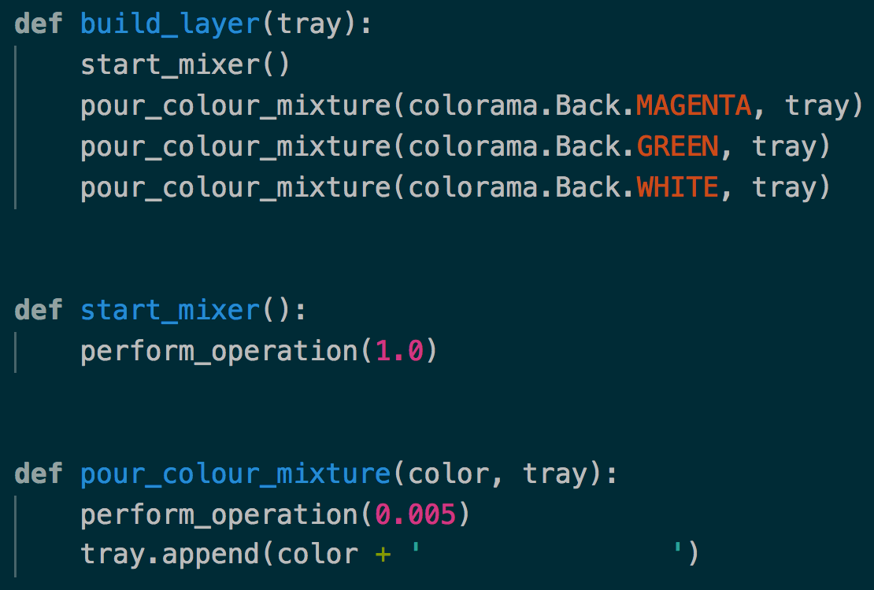
Making of kue lapis sagu

Slide 5
Making of kue lapis sagu

Slide 6
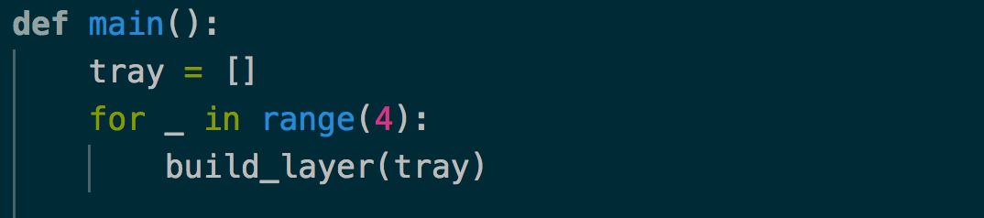
Making of kue lapis sagu

Slide 7
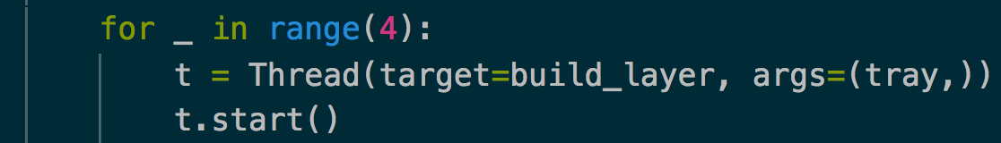
Multithreading

Slide 8
Multithreading
Python interpreter is not thread safe
GIL (Global Interpreter Lock) ensures that only 1 thread can run at a time

Slide 9
Multithreading
A
B
C
Work Table
D
Scheduler

Slide 10
Multithreading
B
A
C
Work Table
D
Scheduler

Slide 11
Multithreading
A
B
C
Work Table
D
Scheduler

Slide 12
Multithreading
A
B
C
Work Table
D
Scheduler

Slide 13
What is the purpose of threading then?

Slide 14
Multithreading
I/O Operation vs Compute Operation
Compute operation occurs in processor
I/O operation occurs outside the processor
Examples
Disk operation
Network operation
Http call or web api
Sleep
Notes:
GIL is released during I/O operation

Slide 15
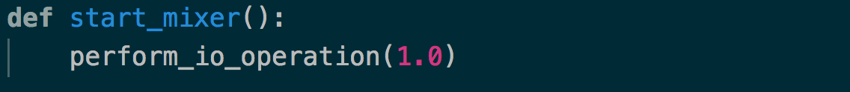
Multithreading

Slide 16
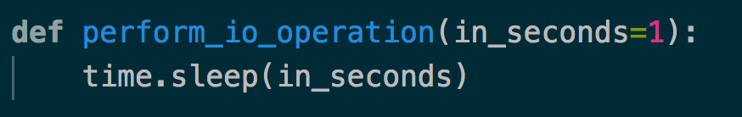
Multithreading

Slide 17
Tip 1: Use multithreading for I/O operation
Watch out for synchronization problem due to preemption

Slide 18
What if I want to achieve parallelism?

Slide 19
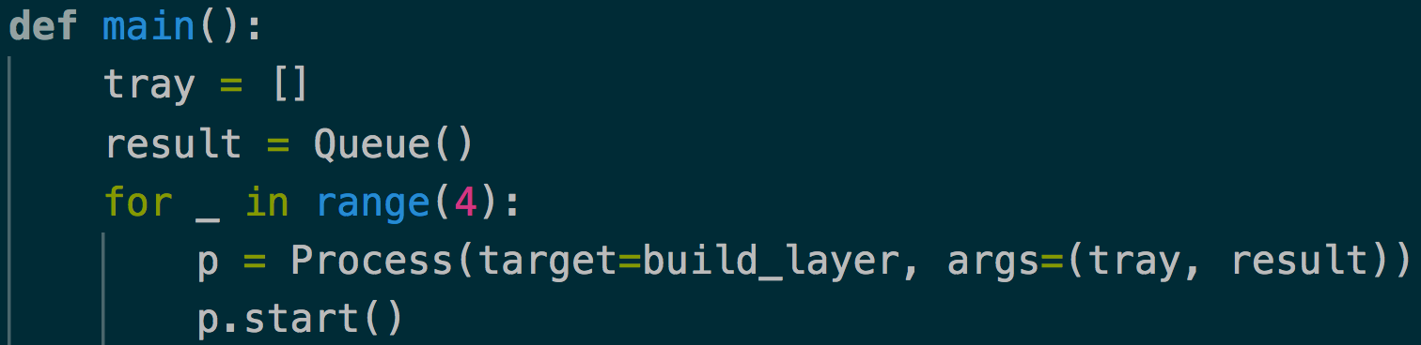
Multiprocessing

Slide 20
Multiprocessing
A
B
C
D
Work Table

Slide 21
Tip 2: Use multiprocessing to achieve parallelism in compute operation
Watch out for the need for serialization

Slide 22
The synchronization problem

Slide 23
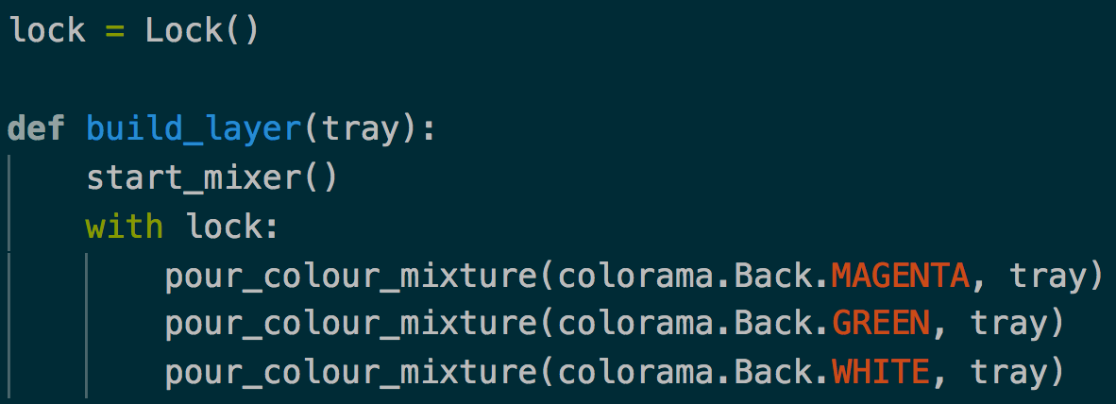
Solution 1: Use lock?

Slide 24
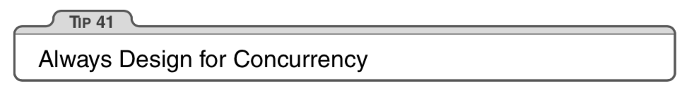
Solution 2: Always design for concurrency
The Pragmatic Programmer by Andrew Hunt and David Thomas
To Prevent: Programming by coincidence

Slide 25
No shared state & No side effect

Slide 26
No shared state
A
REDUCE
B

Slide 27
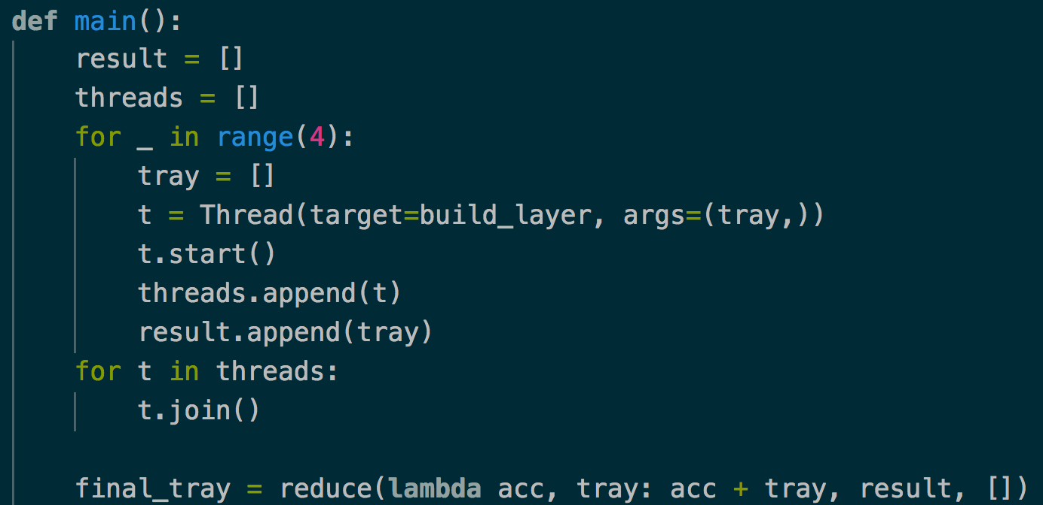
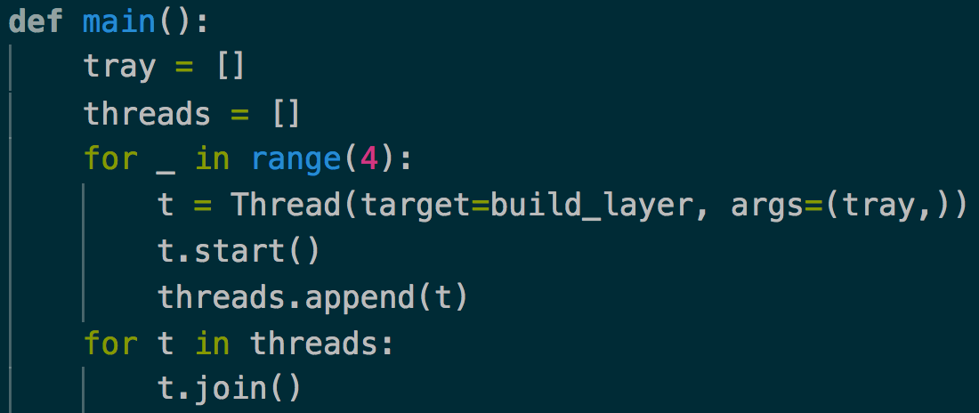
No shared state

Slide 28
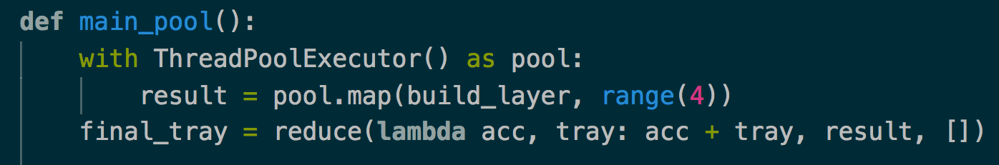
No shared state

Slide 29
Idempotent state
The meaning of the state does not change, even when updates to the state do not happen in the same sequence.

Slide 30
Idempotent state
The meaning of the state does not change, even when updates to the state do not happen in the same sequence.
6
6
6
5
3
5
3
4
3
2
5
4
4
2
2
1
1
1

Slide 31
Idempotent state
6
5
3
DEDUCE
2
4
1

Slide 32
Idempotent state
Inventory management system
12:01:05 Purchase 2 items
12:01:07 Purchase 1 item
12:01:06
Stock 20 items
State
Remaining Items = 2

Slide 33
Idempotent state
Store transaction events which can be played back to calculate the total remaining item.
Idempotent State
12:01:05 Purchase 2 items
12:01:07 Purchase 1 item
12:01:06 Stock 20 items

Slide 34
Design for concurrency
Tip 3: No shared state & no side effect
Tip 4: Use pool.map from concurrent.futures
Tip 5: Have an idempotent state

Slide 35
Once we have designed code for concurrency, we can apply different concurrent model easily.

Slide 36
Restaurant queue
9
8
1
10
7
2
1
Work Table
11
6
3
12
5
4
12 Customers in the queue

Slide 37
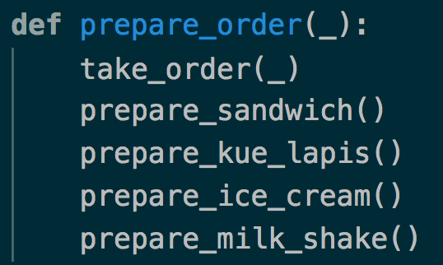
Restaurant queue

Slide 38
Try embarrassingly parallel

Slide 39
Embarrassingly Parallel
9
8
1
1
Work Table
10
7
2
2
Work Table
11
6
3
3
Work Table
12
5
4
4
Work Table
12 Customers in the queue

Slide 40
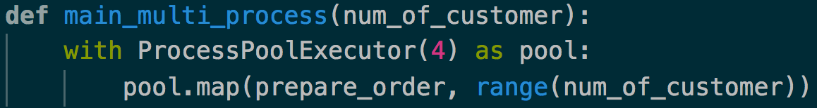
Embarrassingly Parallel
Notes:
Talk about the CSV file validation

Slide 41
Look for I/O operations,
and implement fan-out fan-in model

Slide 42
Fan-out fan-in
Prepare Kue Lapis
Prepare Milk Shake
Prepare Sandwich and Ice cream
Pycon 2014 by Brett Slatkin on fan-out and fan-in: https://youtu.be/CWmq-jtkemY

Slide 43
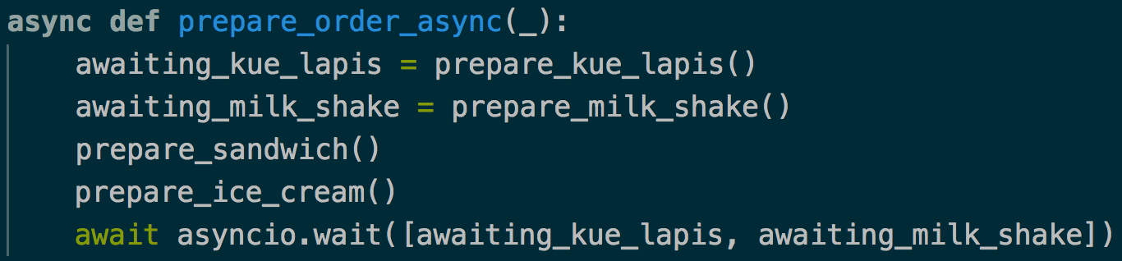
Fan-out fan-in (using asyncio)

Slide 44
Try pipelining

Slide 45
Producer Consumer Queue
9
8
1
10
7
2
1
Work Table
1
11
6
3
2
Work Table
Cashier
12
5
4
Food Preparer
12 Customers in the queue

Slide 46
Producer Consumer Queue
Cashier
Food Preparer
Customer Queue
Order
Completed Queue

Slide 47
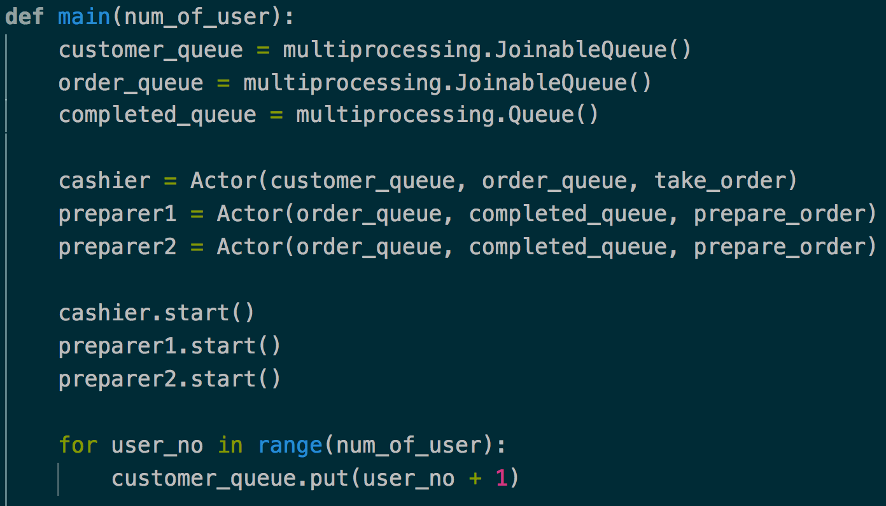
Producer Consumer Queue

Slide 48
Summary
Always (and I mean always) design for concurrency
Understand the basic building block of concurrency in Python
Make use of the appropriate concurrency model.

Slide 49
THANK YOU
For questions or suggestions:
Wilson Tjhi (@wilsontjhi)
wtjhi@thoughtworks.com
Github: wilsontjhi/pycon-asia-2018

